Slide 1
Kennesaw State Football Banquet

Slide 2
Colors
Dominate: Black
Accent: gold and white

Slide 3
Tablecloths
Black Tablecloths

Slide 4
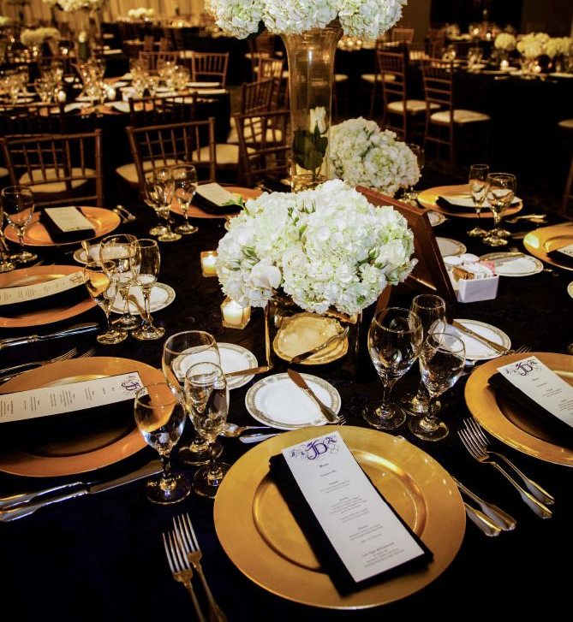
Napkins
Black cloth napkins, folded

Slide 5
Plates
Gold Chargers and white plates

Slide 6
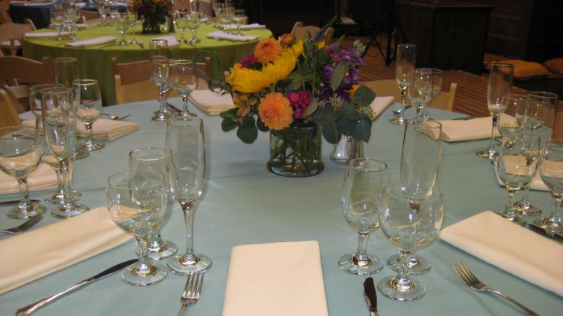
Glassware
Water, wine, and champagne

Slide 7
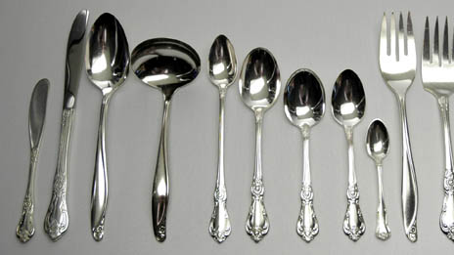
Utensils
Simple yet elegant

Slide 8
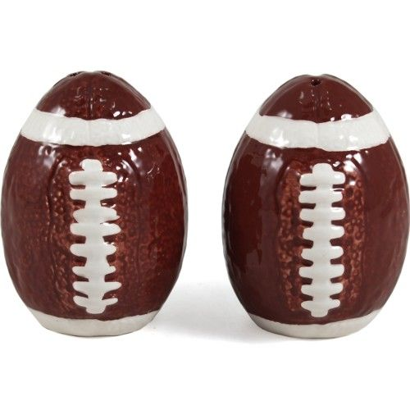
Salt and Pepper Shakers
To add a touch whimsical to the theme

Slide 9
Centerpieces
Elegant but shows school spirit

Slide 10
Décor

