Slide 1
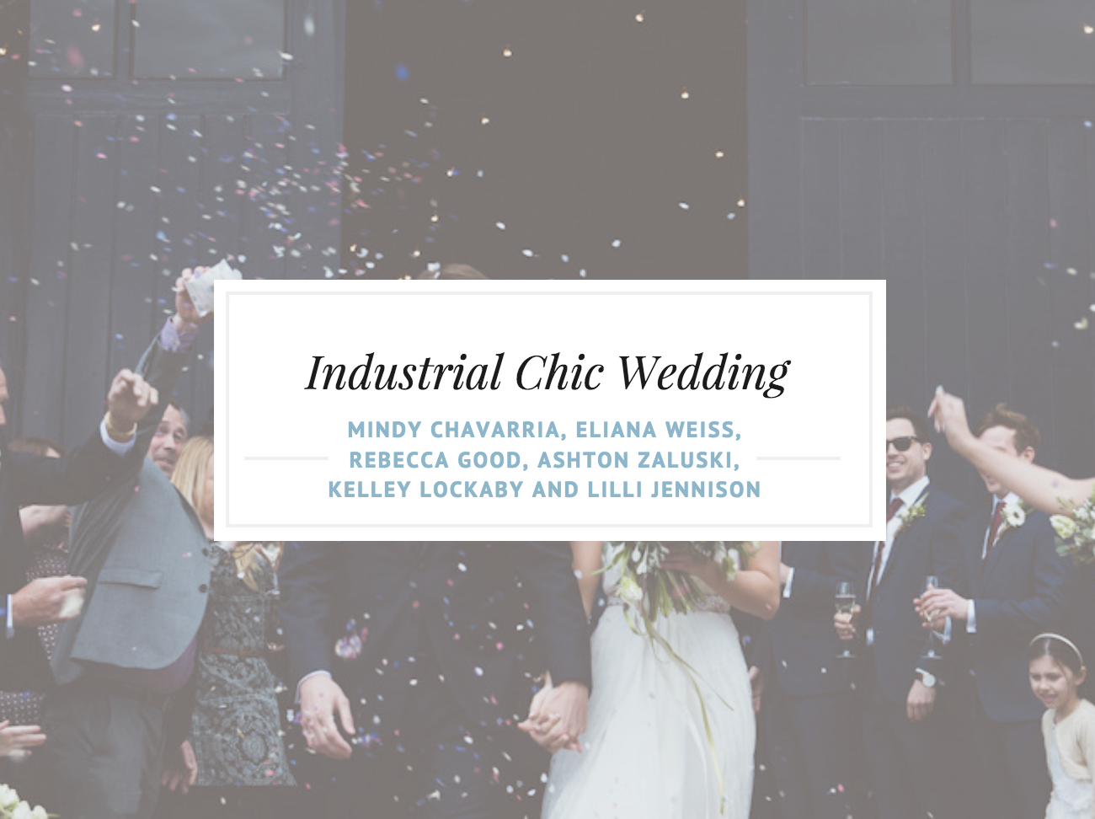
Industrial Chic
Wedding
Mindy Chavarria, Eliana Weiss, Rebecca Good, Ashton Zaluski, Kelley Lockaby and Lilli Jennison

Slide 2
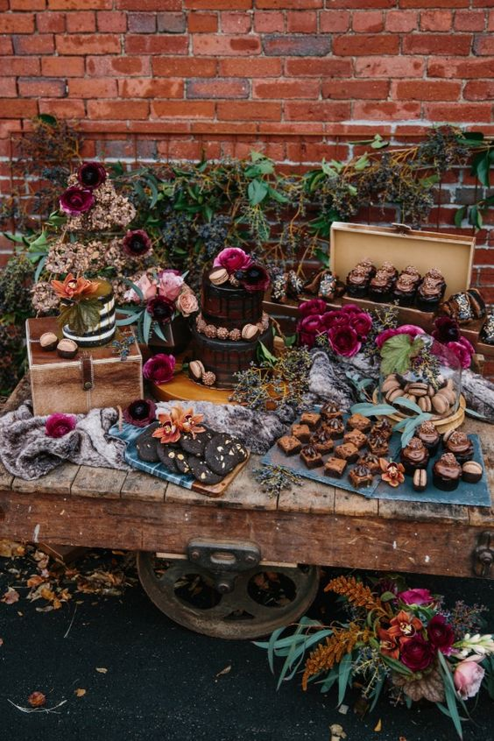
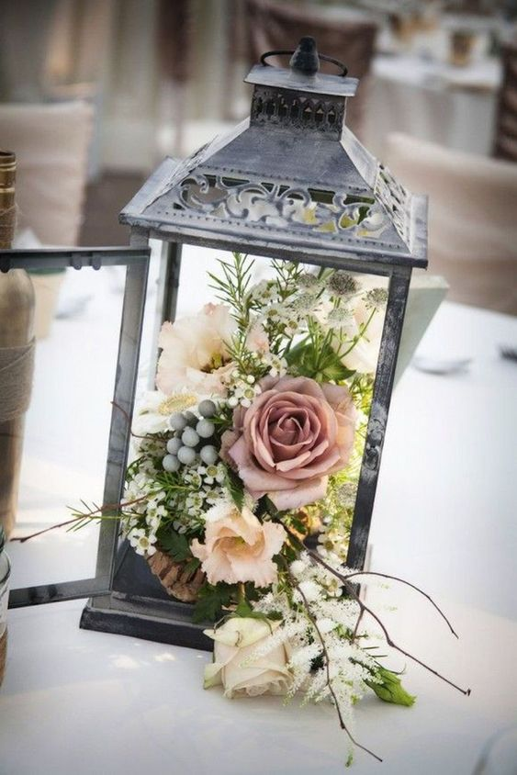
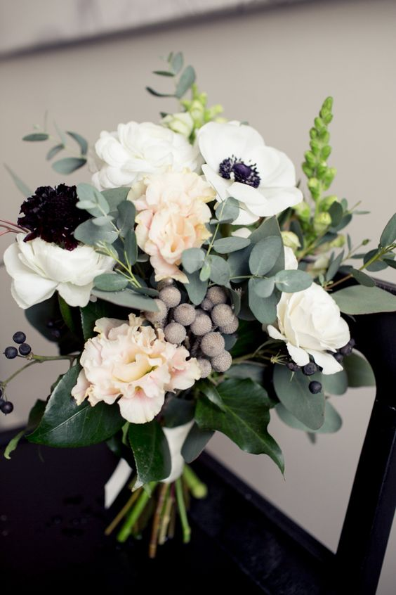
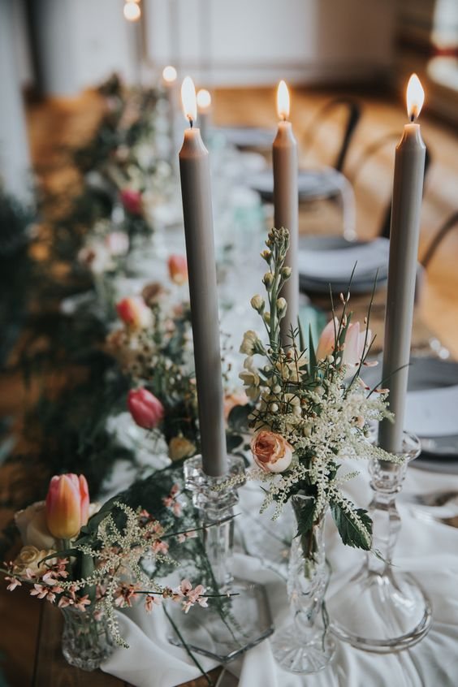
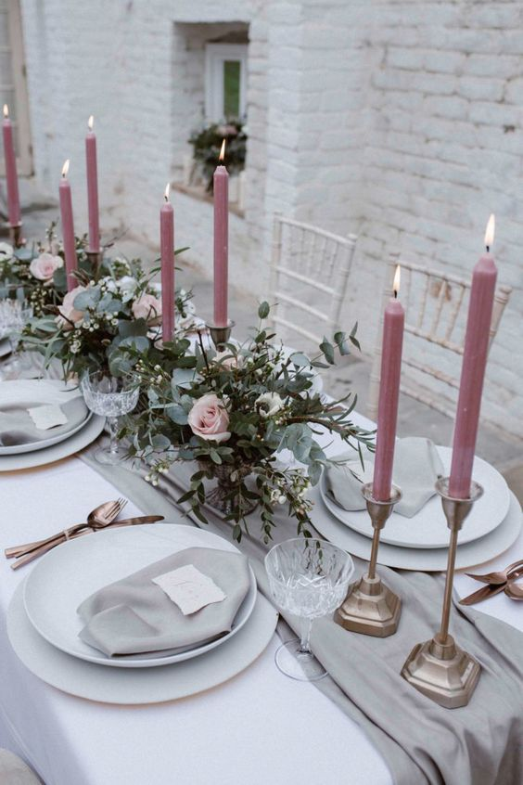
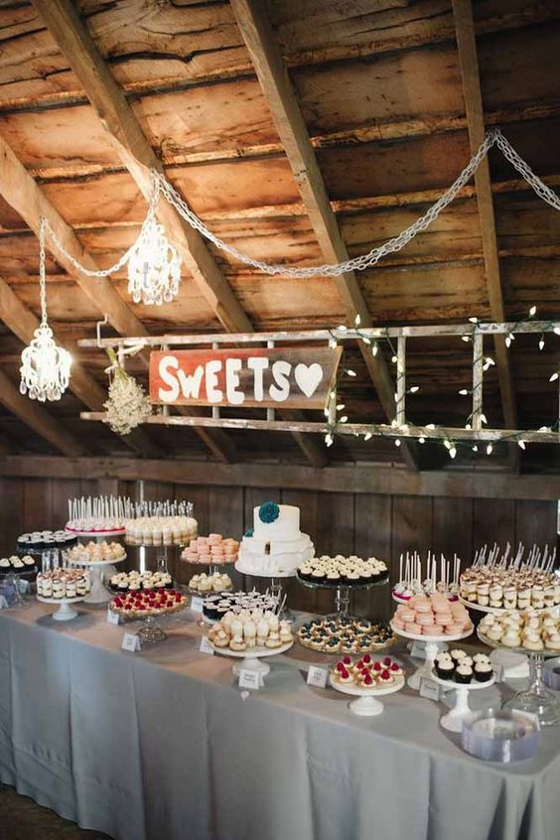
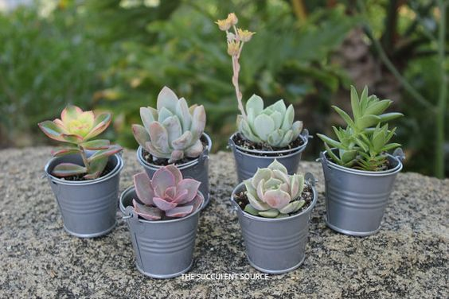

Slide 3
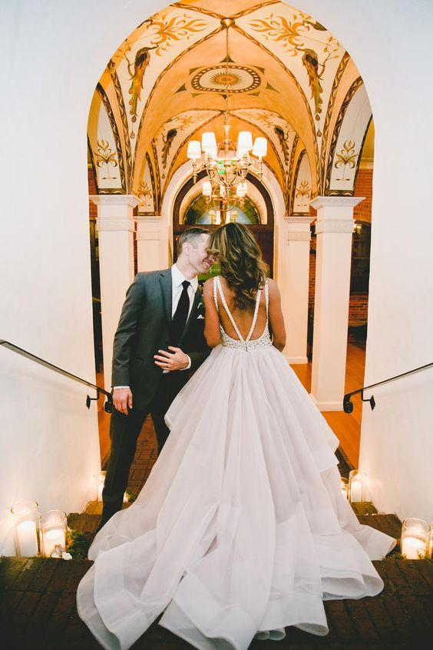
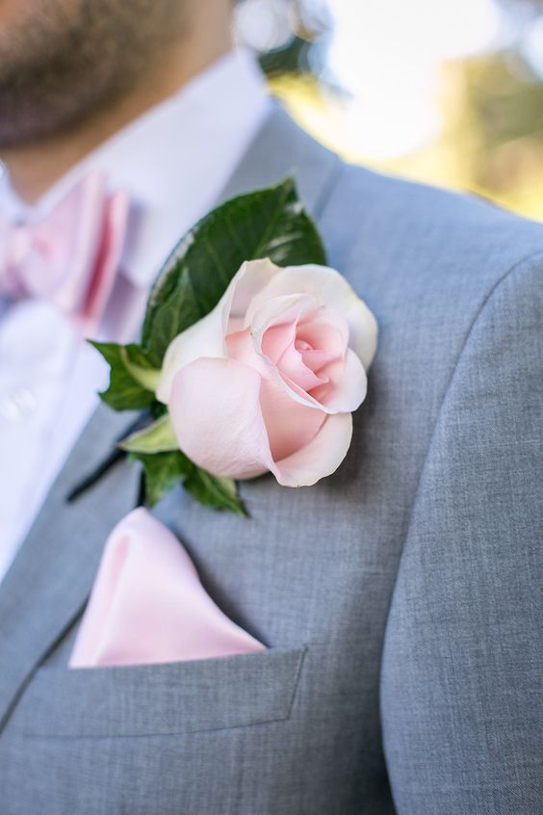
COLOR SCHEME

Slide 4
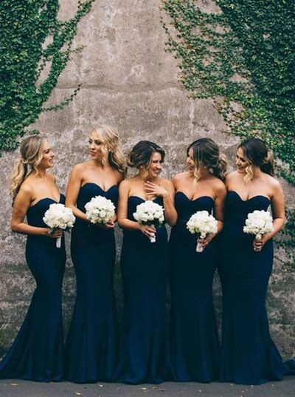
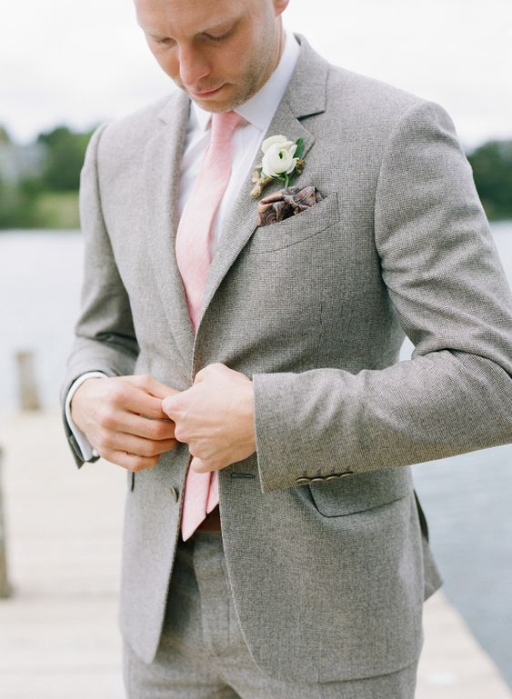
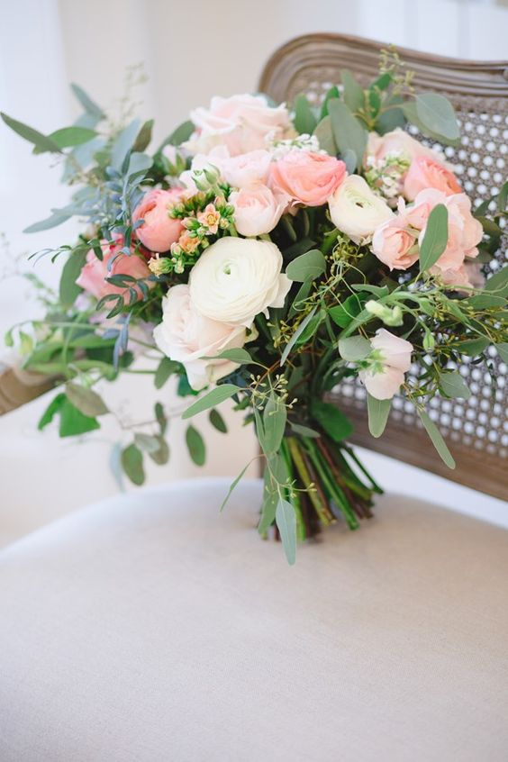
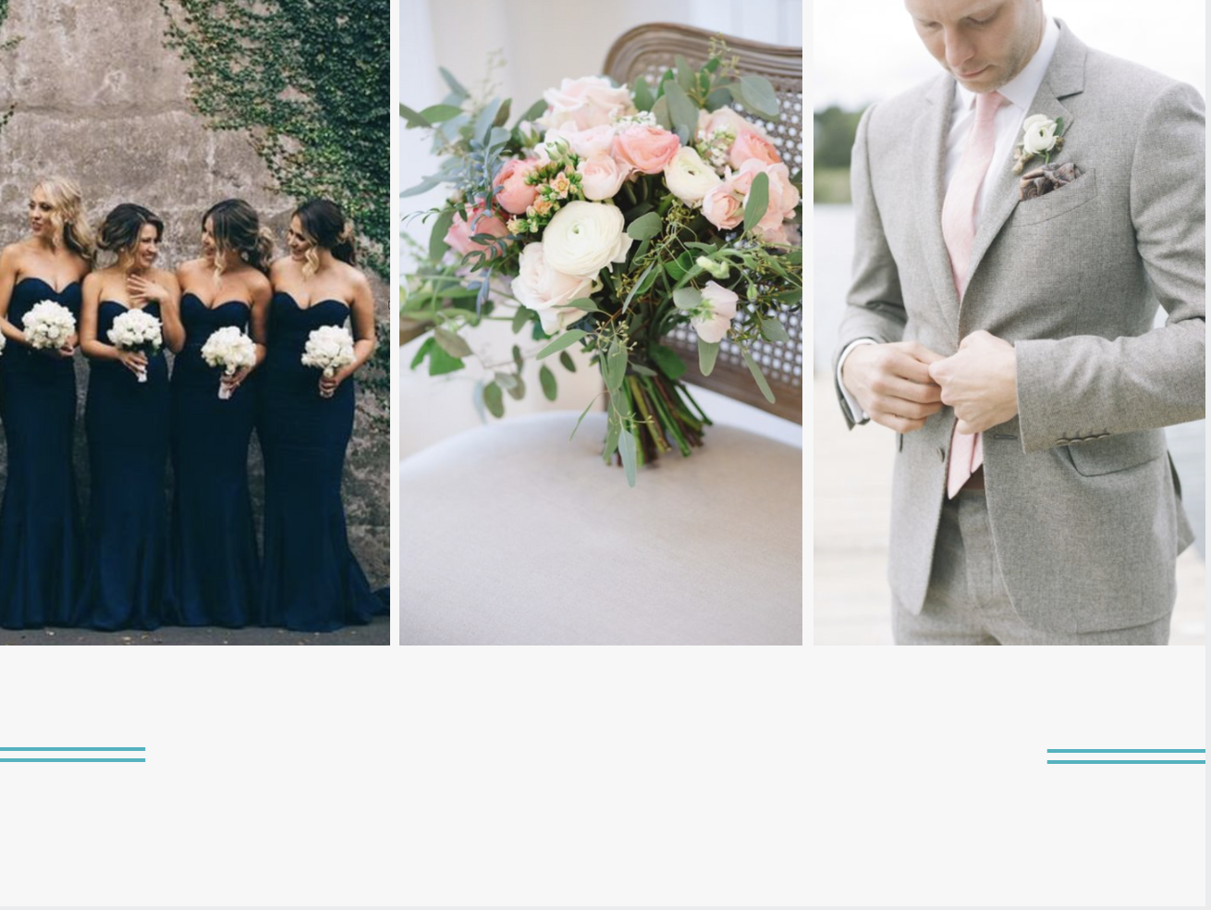
YOU & ME
YOU & ME

Slide 5
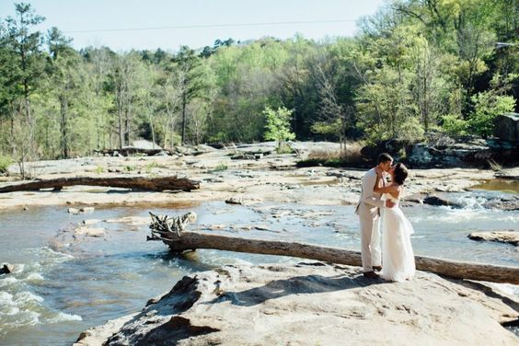
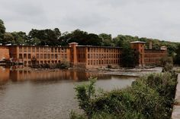
The Mill at Yellow River
The
V
E
N
U
E

Slide 6
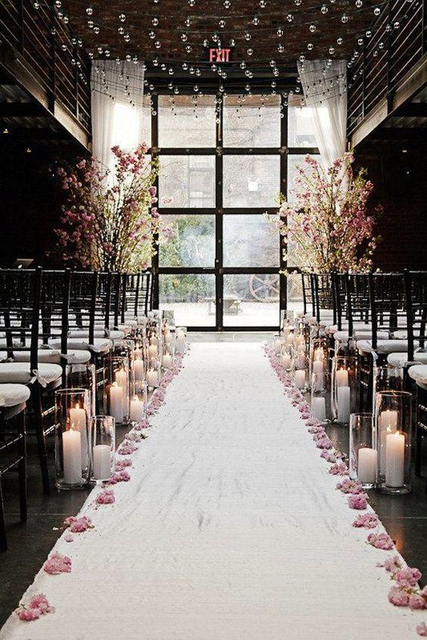
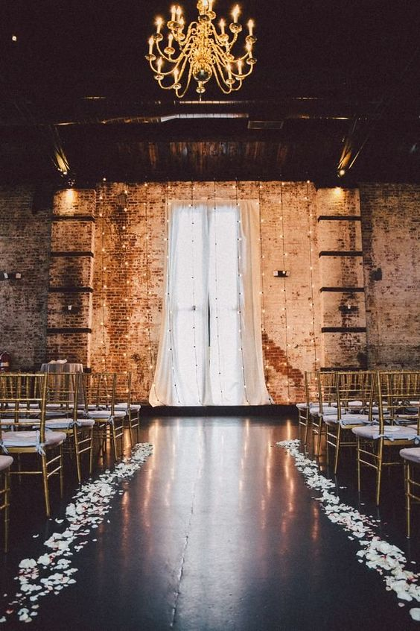
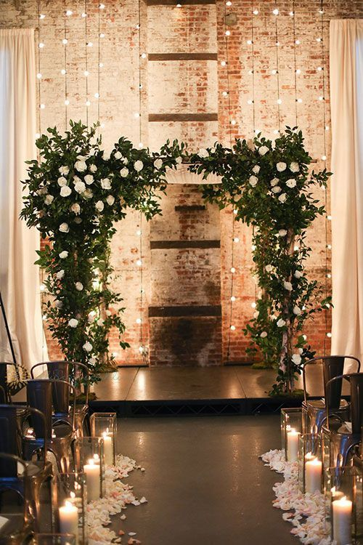

Slide 7
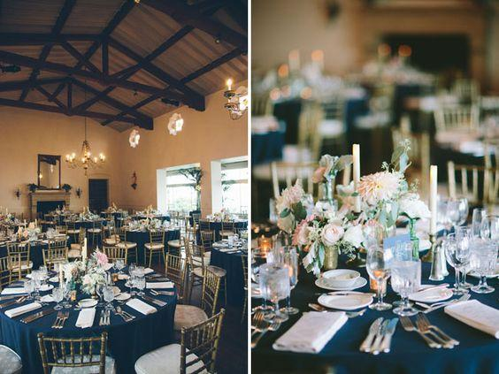
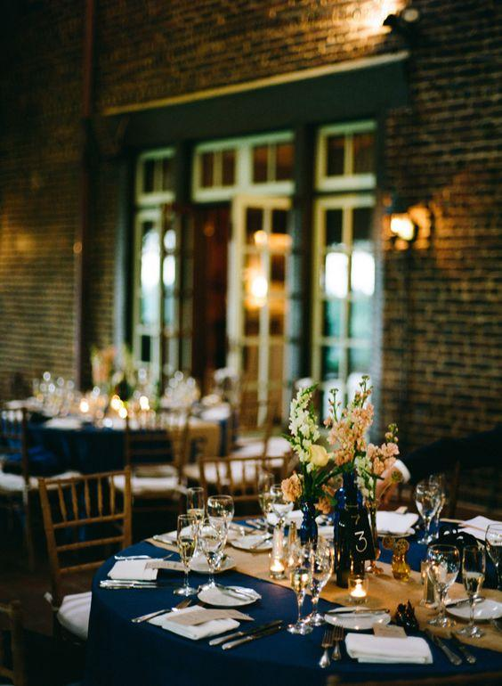
RECEPTION SEATING & LINENS

Slide 8
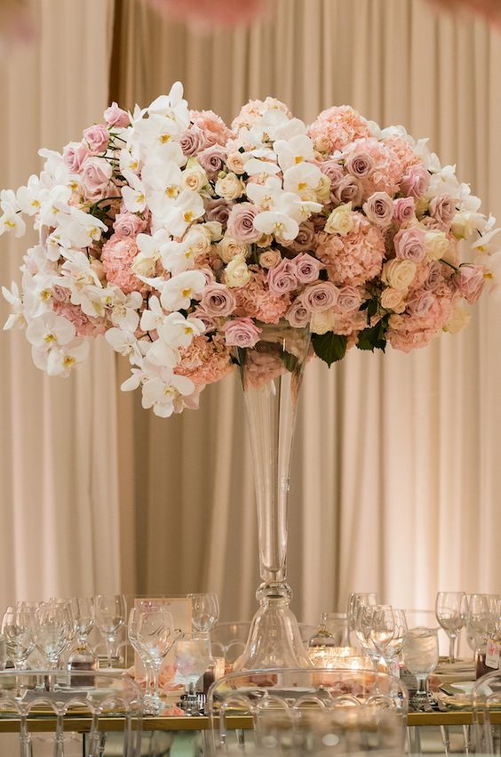
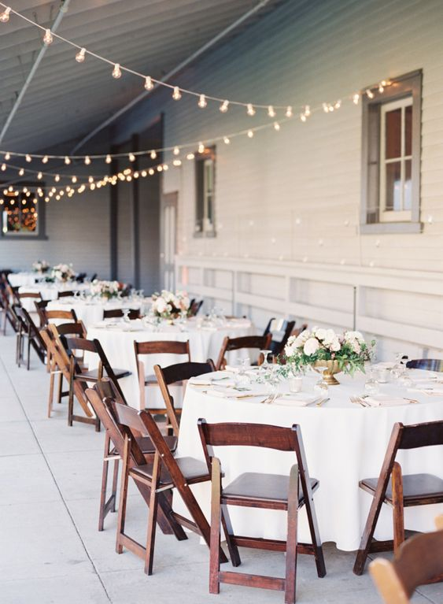
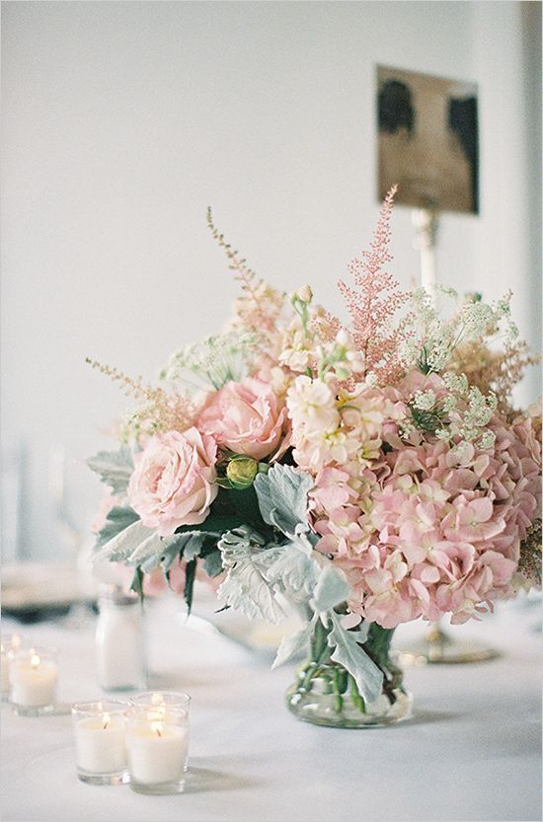
HIGH & LOW CENTERPIECES
CHAIRS & LINENS

Slide 9
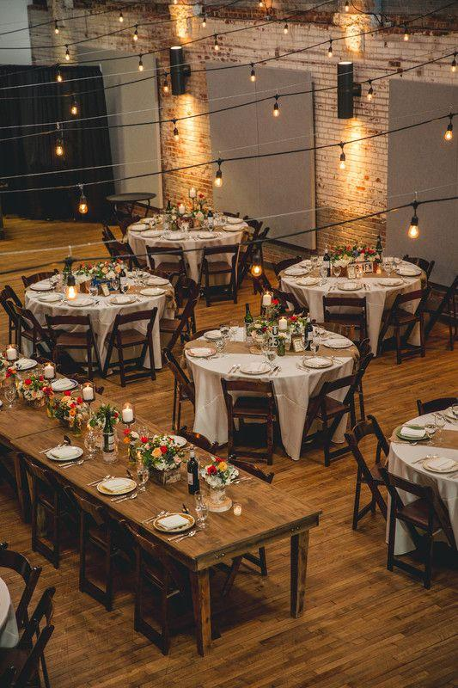
LINENS
23 Tables to cover the guest amount-
(8 people per table/180 people is 22.5).
Each table holds 8 people therefore for 184 guest plus the 16 for the wedding party (14 wedding party + bride and groom).
1 X 8’ rectangle (90 x 156”) for estate table
1 X 90x132 rectangle linen for dessert table
1 X 120 round linen for the gift table
14 X 90x132 rectangle linens + 14 runners
7 x 120 rounds for guest tables
8 X 30” “highboy tables” for cocktail hour (120”/132”)
4 X 36” rounds for cocktail tables (96”)
3 X polyester 90 x 132” rectangle linens for
Food/Catering tables
The bar does not need a linen coverage
As well as DJ stand

Slide 10
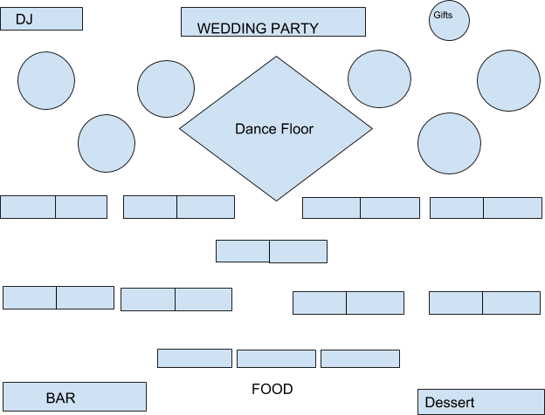
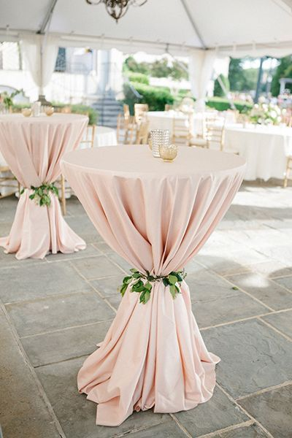
FLOOR PLAN

Slide 11
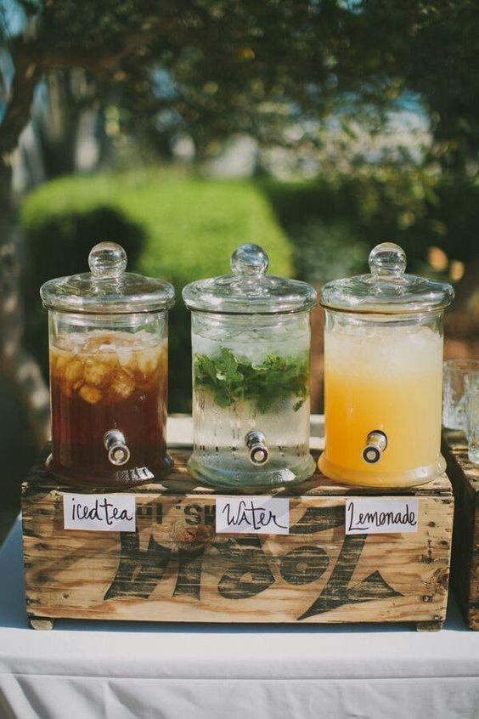
FULL OPEN BAR!!

Slide 12
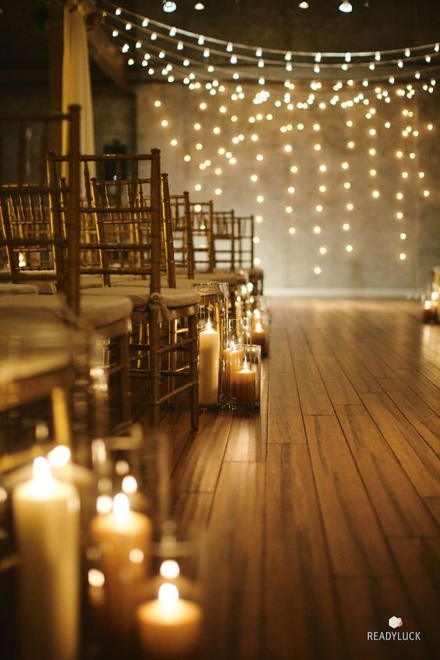
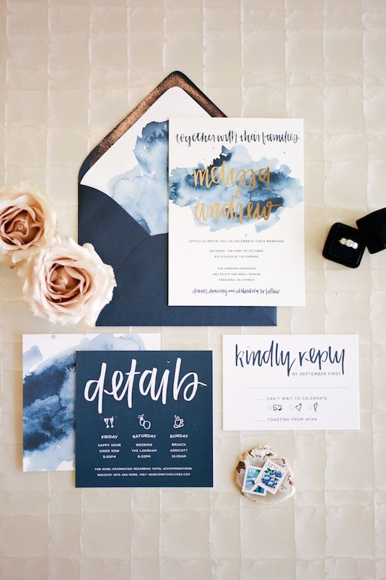
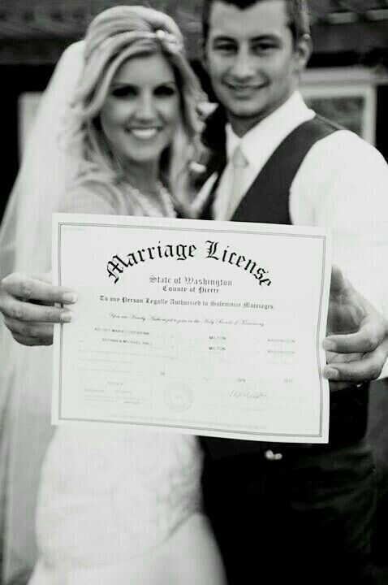
MINOR
DETAILS

Slide 13
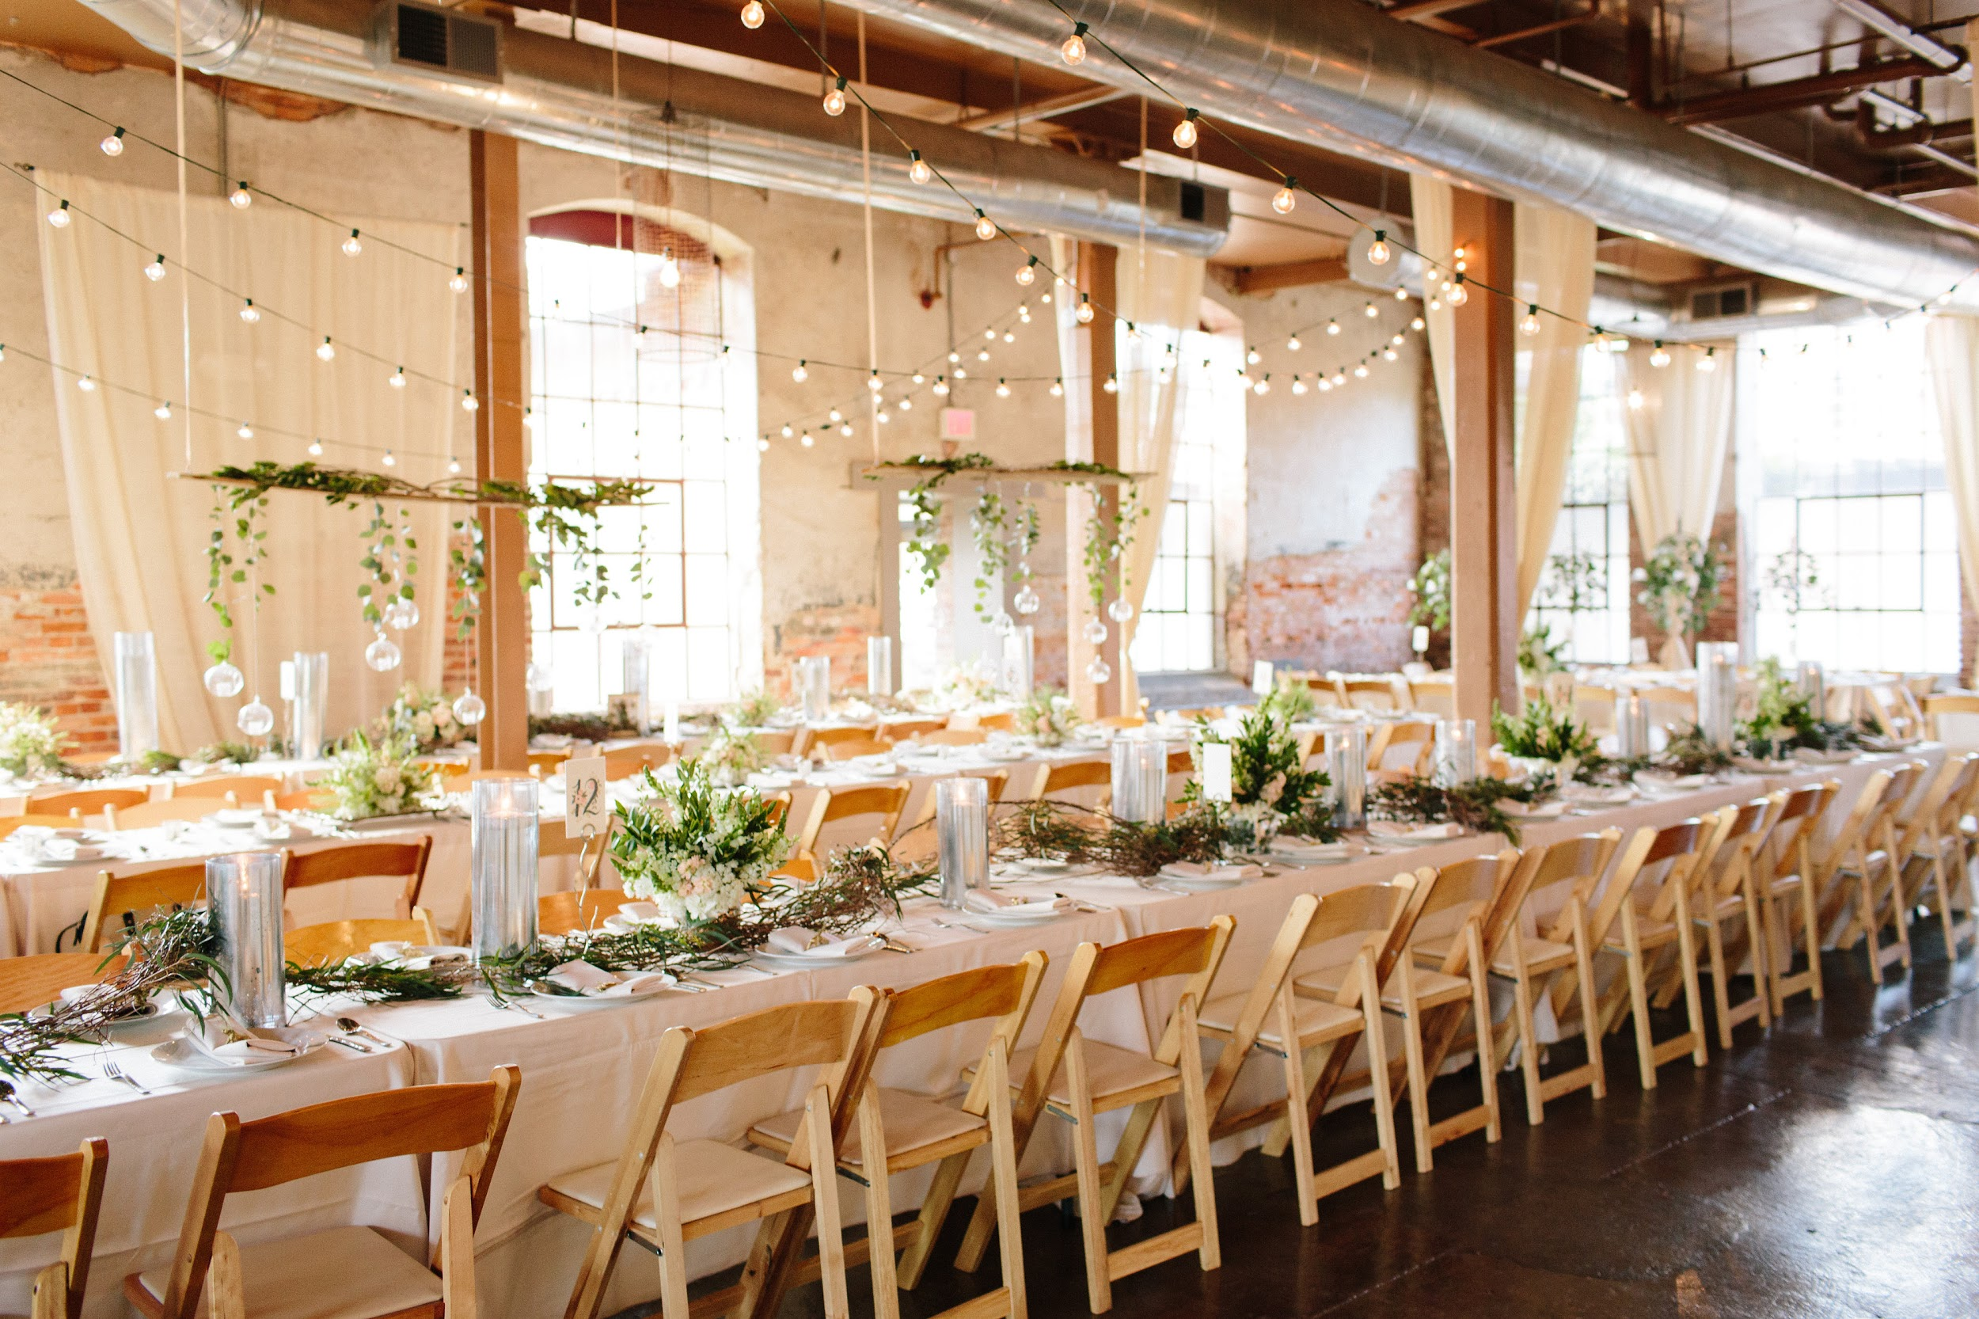
Budget
Catering
Station Style $10,449
Horderves $4,500
Desserts $0
Open Bar $2,700
Bartender Service $0
Ceremony
Music $450
Officiant $350
Marriage License $57
Venue
The Mill at Yellow River $999

Slide 14
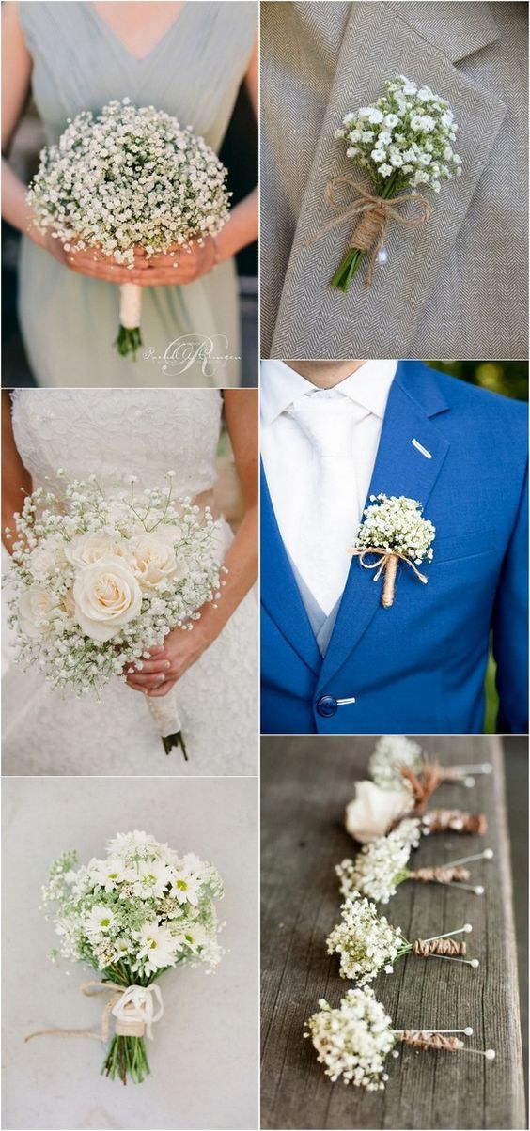
Photography/Videographer
Photographer (Victoria Huff Photography) $3,000
Videographer (Petit Four Films Atlanta) $3,499
Floral Decor
Bride $199
Bridesmaids (7) $903
Boutonnieres (7 groomsmen, father of bride, father of
groom, grandfathers,ushers) $323
Mother of Bride, Mother of Groom, Grandmothers $100
Flower Girl $30
Tall Arrangements (18 tables) $2,250
Low Arrangements (18 tables) $1,062

Slide 15
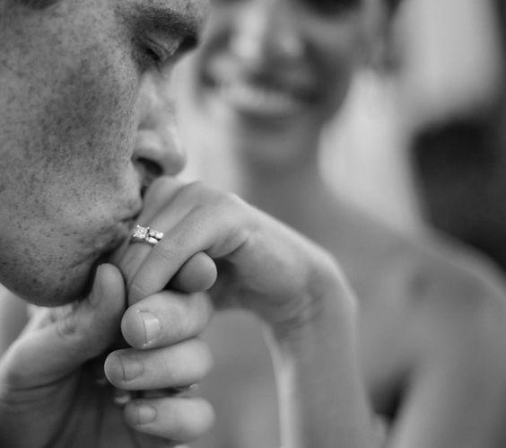
Decor
Linens $0
Lighting $50
Draping $2,500
Reception
Music $1,595
Invitations
Programs and Table Cards $747
Invitations + RSVP Cards $417
Save the Dates
+ Thank You Notes $399
Fashion
Wedding Dress $3,000
Veil $129.99
Accessories $132.65
Bridal Party Makeup $675
Bride’s Makeup $165
Bride’s Hair $150
Bridal Party’s Hair $525
Flower Girl Hair $45

Slide 16
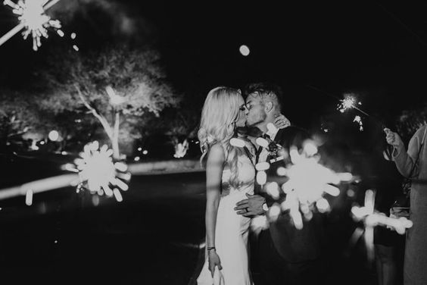
Miscellaneous
Guest Book and Pen $25
Ring Bearer Pillow $25
Flower Girl Basket $25
Unity Candle for Ceremony $25
Favors
Wedding Favors $900
Lodging and Transportation
Lodging $819
Transportation $1,600
Wedding Planner
Full Service Planner $6,000
Industrial Chic Wedding
Grand Total $50,820.64

Slide 17
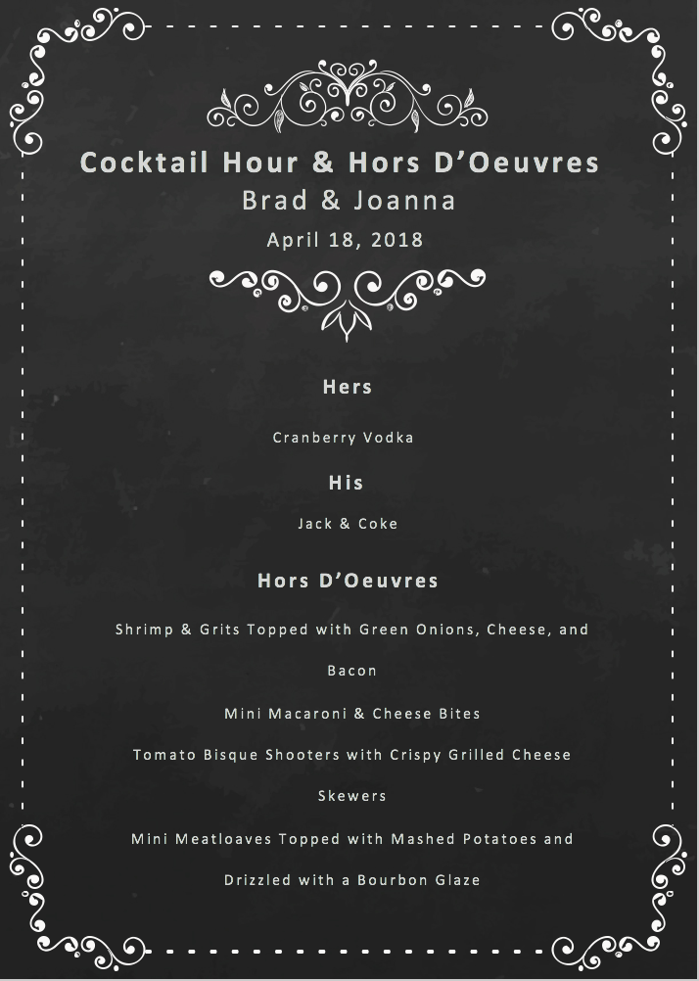

Slide 18
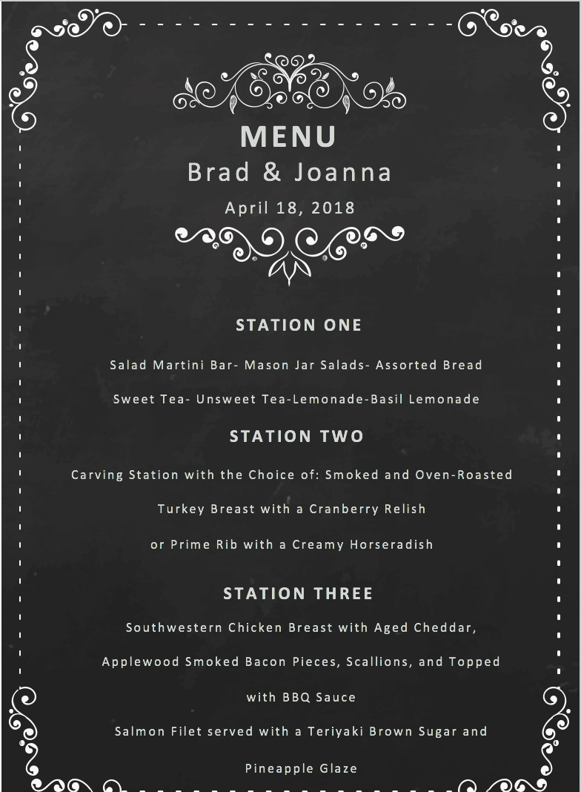
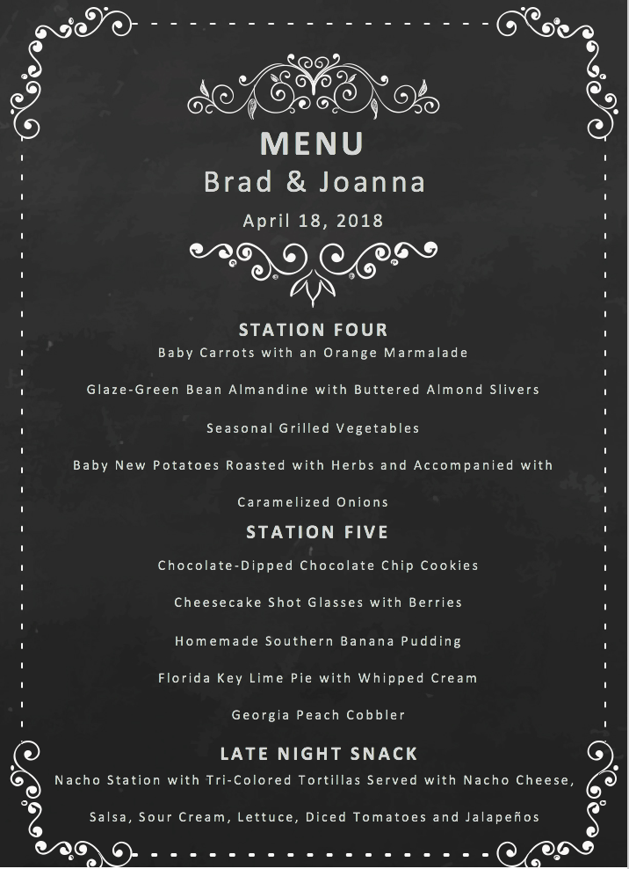

Slide 19
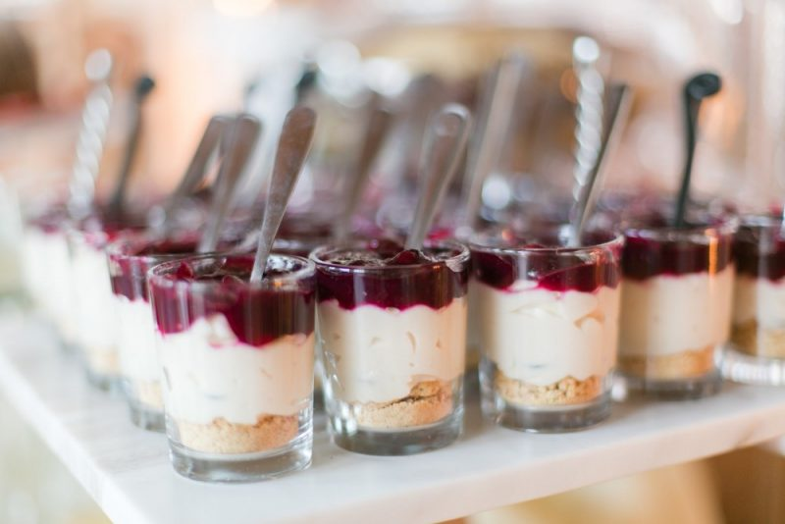
DESSERT TIME
Yummm..

Slide 20
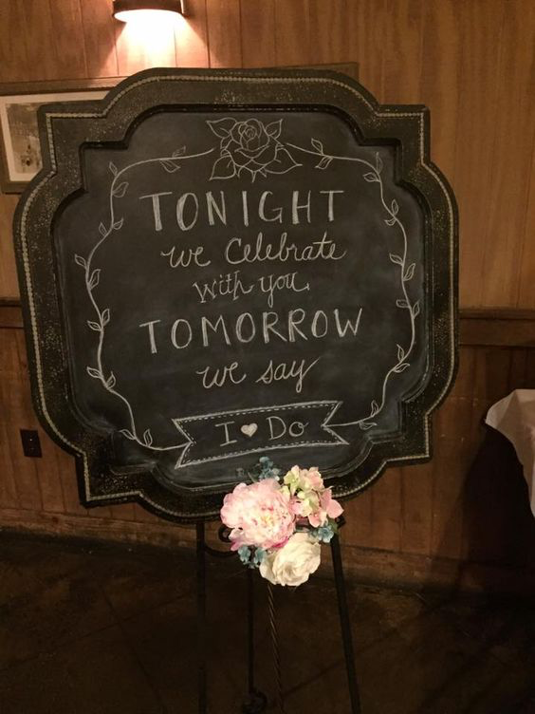
Wedding Weekend Timeline
Friday (day before the wedding)
Bridesmaids Luncheon: 11:00 AM
Hotel Check-In: 1:00 PM
Rehearsal: 5:30 PM
Rehearsal Dinner to follow: 6:30 PM

Slide 21
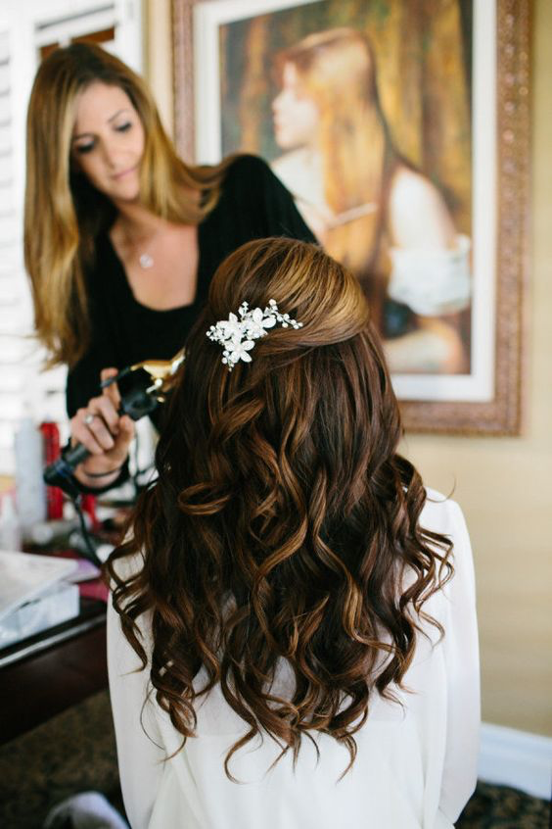
Saturday (day of wedding)
Transportation Arrival Time for Wedding Party: 8:30 AM
Wedding Party Arrival Time at Venue: 8:45 AM
Arrival of Hair and Makeup Teams: 8:45 AM
Transportation Pick Up Time for Family: 11:30 PM
Family Arrival Time at Venue: 12:00 PM
HAIR (2 Hair Stylist)
Bridesmaid 2: 8:15 AM
Bridesmaid 3: 8:15 AM
Bridesmaid 4: 9:30 AM
Bridesmaid 5: 9:30 AM
BRIDE: 11:30 AM
MAID OF HONOR (bridesmaid 1): 11:30 AM
Bridesmaid 6: 10:45 AM
Bridesmaid 7: 10:45 AM

Slide 22
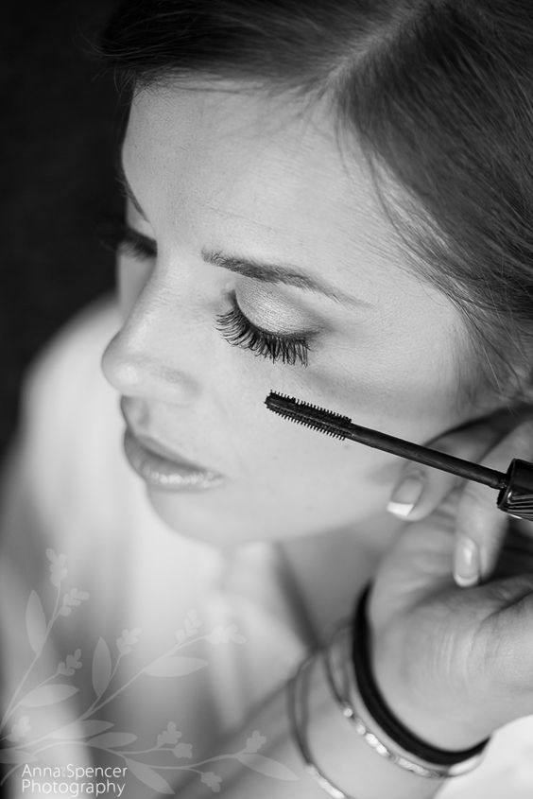
MAKE-UP (2 Artists)
Bridesmaid 7: 8:15 AM
Bridesmaid 6: 8:15 AM
BRIDE: 9:30 AM
MAID OF HONOR (bridesmaid 1): 9:30 AM
Bridesmaid 5: 10:45 AM
Bridesmaid 4: 10:45 AM
Bridesmaid 3: 11:30 PM
Bridesmaid 2: 11:30 PM
Lunch Service: 12:00 PM
Arrival Time of Photographer: 12:45 PM
Arrival Time of Personal Flowers: 1:30 PM
Catering Load-in: 2:00 PM
DJ Load-in: 2:00 PM
Decor Load-in: 2:00 PM

Slide 23
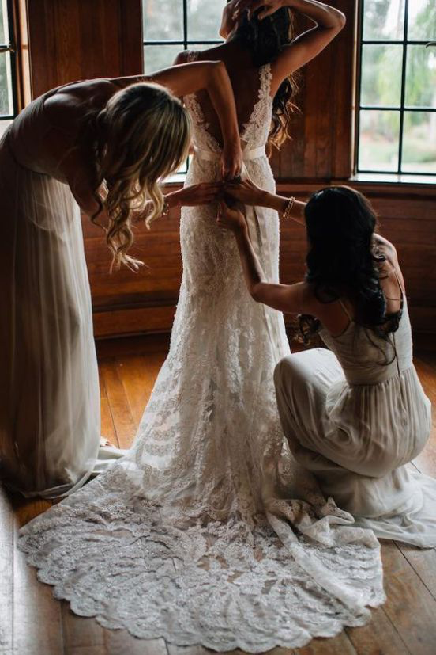
TIMELINE CONTINUED...
Dress Time of the Bridesmaids: 2:00 PM
Dress Time of the Groom and Groomsmen: 1:45 PM
Groomsmen Photos: 2:00 PM
Dress Time of the Bride: 2:00 PM
Bridesmaid Photos: 2:30 PM
First Look: 2:45 PM
Couple Photos: 3:00 PM
Family Photo Time: 4:00 PM
Guest Transportation Pick Up Time: 4:30 PM

Slide 24
(Order of Ceremony Processional: Officiant, Groom,
Grandparents, parents, bridesmaids and groomsmen, flower girl and ring bearer, bride. )
Ceremony Start Time: 5:30 PM
Ceremony End Time: 6:00 PM
Cocktail Hour Timing: 6:00-7:00 PM
Wedding party introductions: 7:05 PM
First dance: 7:15 PM
Dances with parents: 7:20 PM
Dinner: 7:30-8:30 PM
Toasts and speeches: 8:25-9:00 PM
Evening Shuttle Start Time: 9:30 PM
Cake cutting: 9:00 PM
Thank You by bride and groom: 9:15 PM
Late Night Snack Service: 10:30 PM
Last Call: 11:00 PM
Wedding End Time: 12:00 AM

Slide 25
Vendor Contact Information
Beyond Details:
The Mill at Yellow River
Phone: 770.784.7001:
Email: info@BeyondDetails.net
Baker:
Bob Smith: 888-796-4455
Caterer:
Bill Johnson: 999-796-5544
Florist:
Meredith Jones: 789-859-6325
Hair stylist (2):
James Bryan: 458-214-3256
Bailey Sysco: 236-397-9909
Makeup Artist (2):
Mary Thomas: 236-562-1542
Ashley Bell: 236-854-2413
Venue Contact:
Kate Maye: 236-562-2457
Liquor supplier:
Jerry King: 365-213-3258

Slide 26
Vendor Contact Information (Continued)
Victoria Huff Photography: (706) 255-1324
Photographer
Petit Four Films Atlanta: 470.299.7519
Videographer
Taylor-Made Weddings:770-316-9908
Officiant
DJ Dre:
404-259-3284
Music: Reception
Etude Entertainment:
404 574 3980
Music: Ceremony
Lumee Both:
470-588-7753
Photo Booth

Slide 27
Thanks for being apart of our big day becoming
mr. & Mrs.

